Slide 1
Opportunities and Dangers in Large Scale
Data Intensive Computing
Douglas Thain
University of Notre Dame
Large Scale Data Mining Workshop
at SIGKDD August 2011

Slide 2
The Cooperative Computing Lab
We collaborate with people who have large scale computing problems in science, engineering, and other fields.
We operate computer systems on the scale of 1000 cores.
We conduct computer science research in the context of real people and problems.
We publish open source software that captures what we have learned.
http://www.nd.edu/~ccl

Slide 3
The Good News:
Computing is Plentiful
My personal workstations / servers.
A shared cluster at my school / company.
A distributed batch system like Condor.
An infrastructure cloud like Amazon EC2.
A platform cloud like Azure or App Engine.

Slide 4
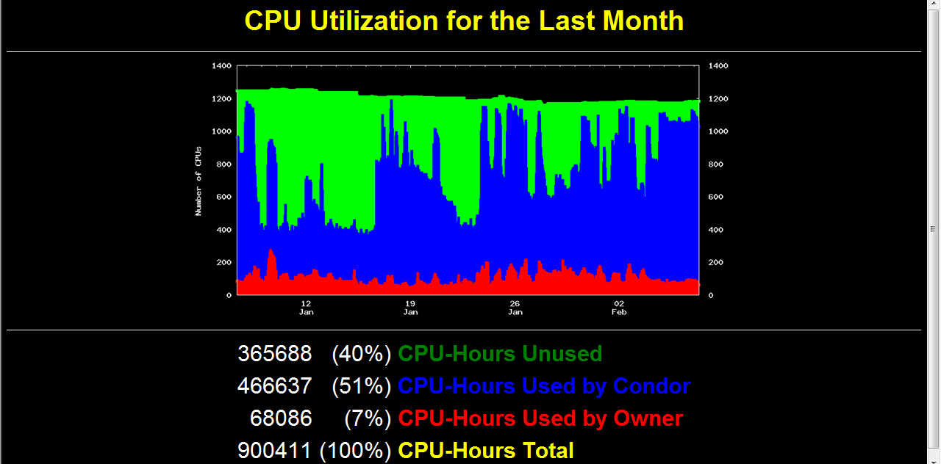

Slide 5
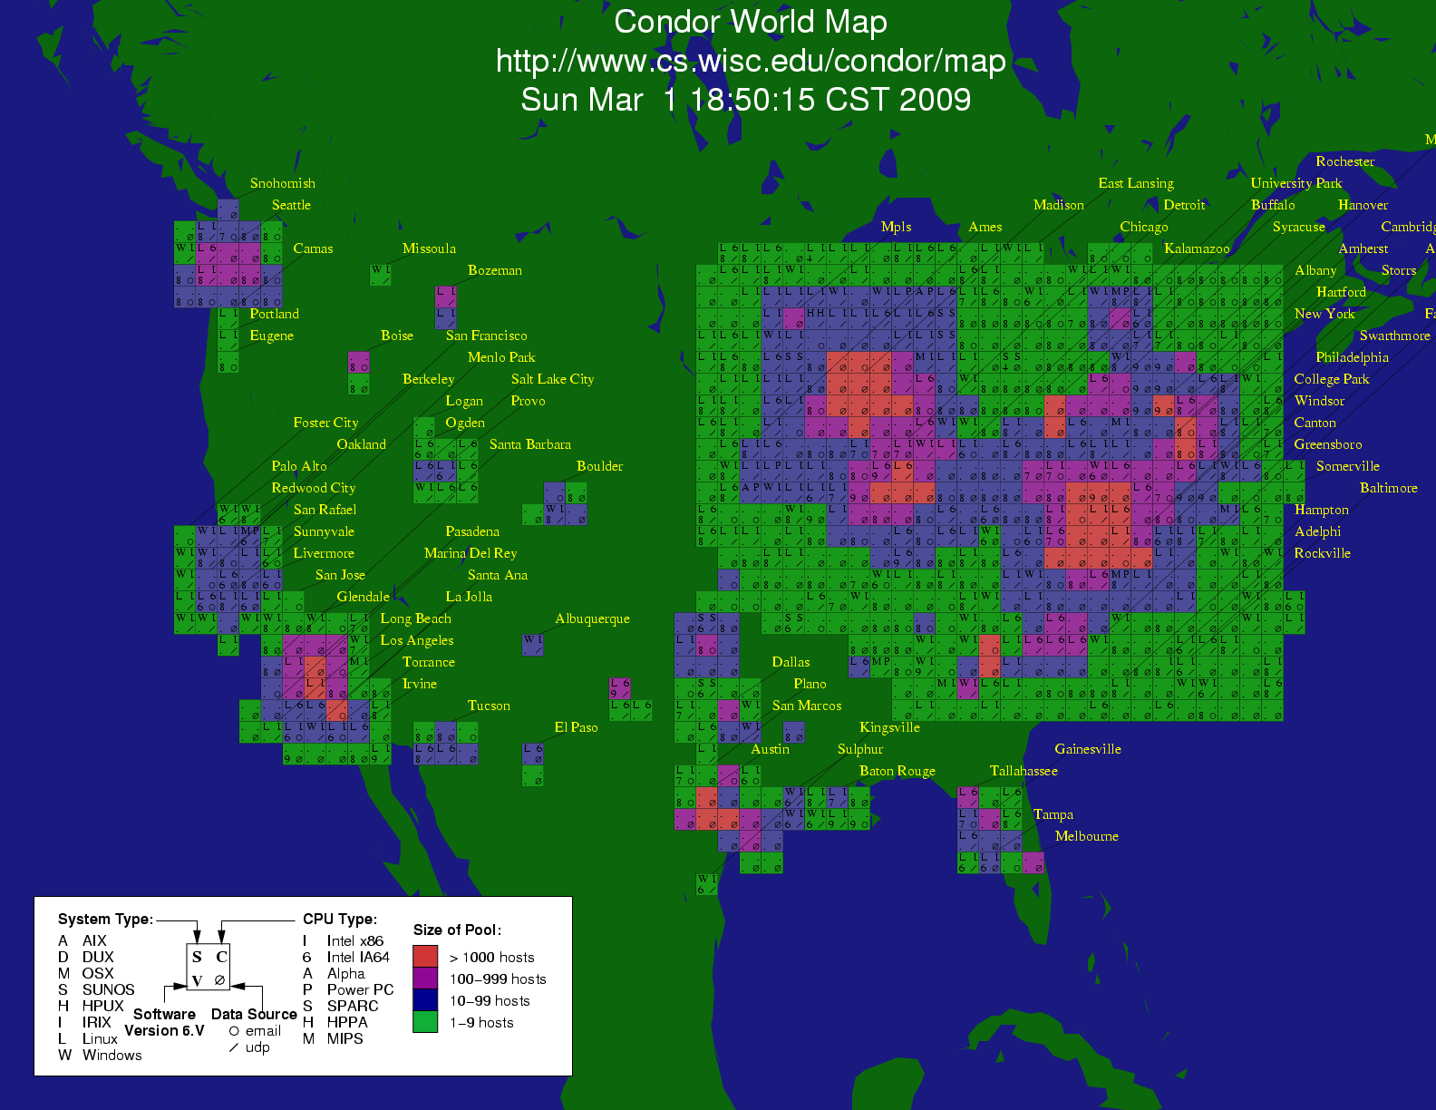
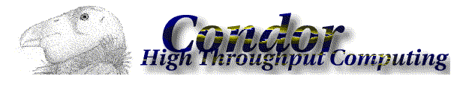

Slide 6
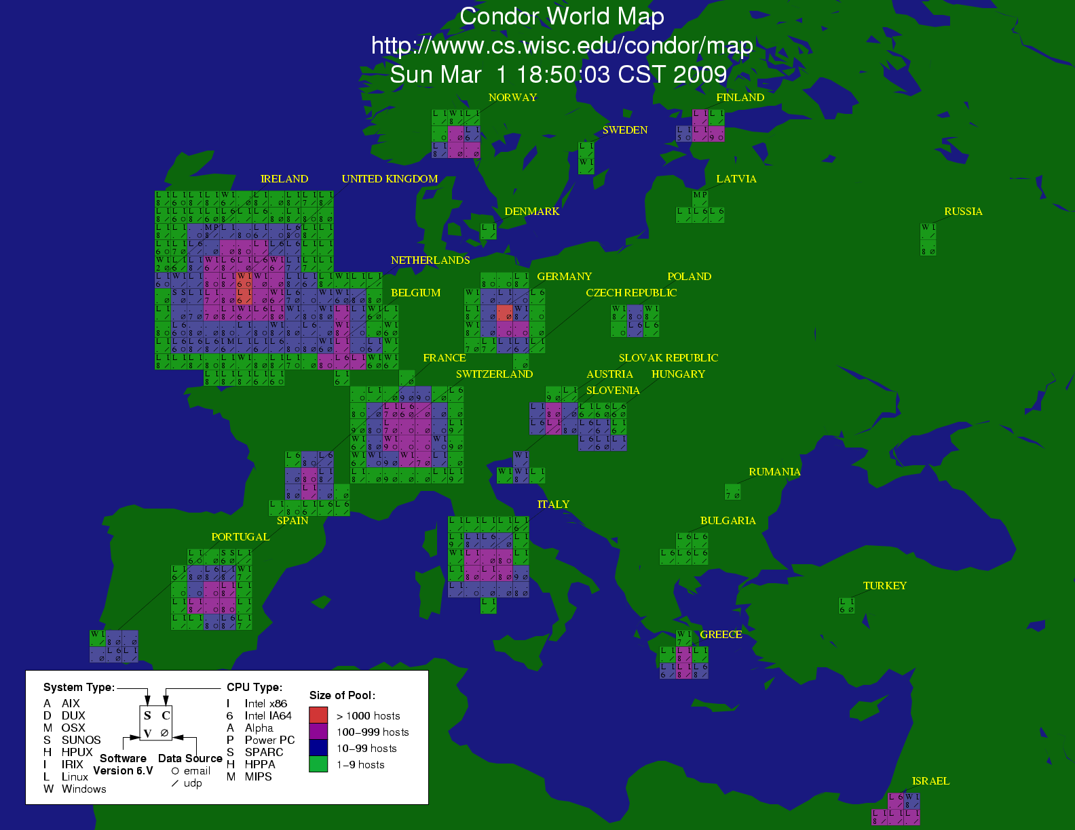

Slide 7
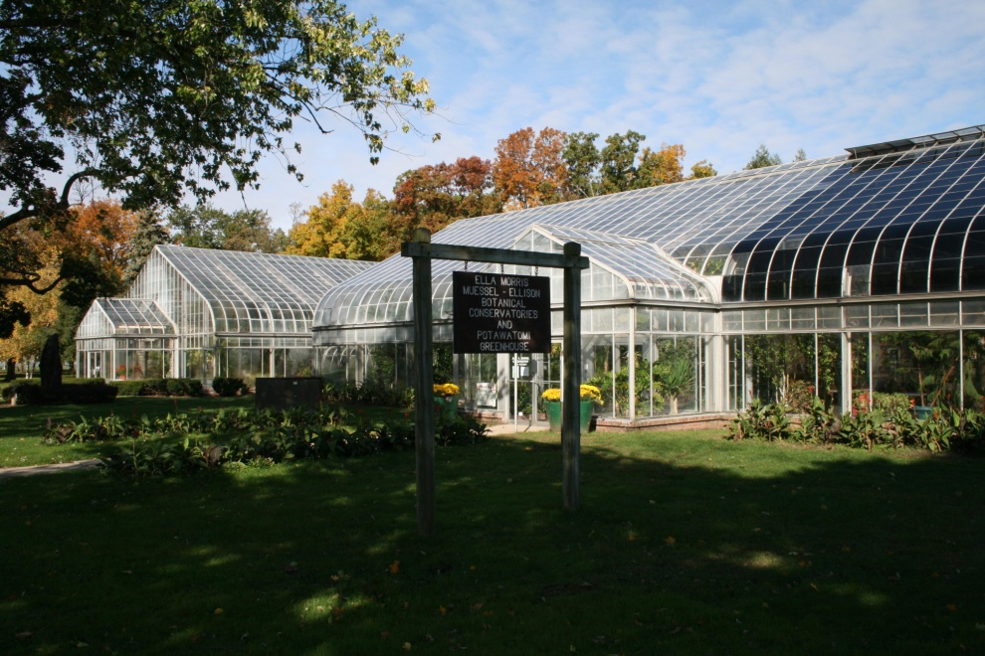
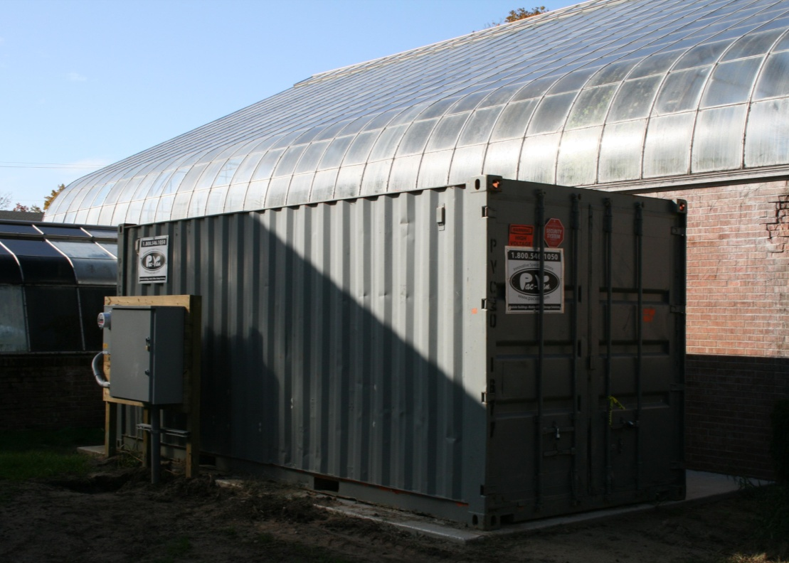
greencloud.crc.nd.edu

Slide 8
Bad News:
These systems are not dedicated to me.
Many systems = many interfaces.
Application may not be designed for distributed / parallel computing.
Relationship between scale and performance is not obvious.
Real cost of running app is not obvious.

Slide 9


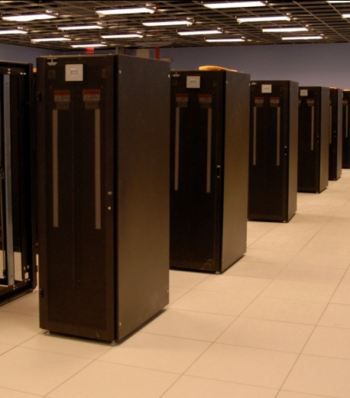
I have a standard, debugged, trusted application that runs on my laptop.
A toy problem completes in one hour.
A real problem will take a month (I think.)
Can I get a single result faster?
Can I get more results in the same time?
Last year,
I heard about
this grid thing.
This year,
I heard about
this cloud thing.
What do I do next?

Slide 10
Our Application Communities
Bioinformatics
  I just ran a tissue sample through a sequencing device. I need to assemble 1M DNA strings into a genome, then compare it against a library of known human genomes to find the difference.
Biometrics
  I invented a new way of matching iris images from surveillance video. I need to test it on 1M hi-resolution images to see if it actually works.
Data Mining
  I have a terabyte of log data from a medical service. I want to run 10 different clustering algorithms at 10 levels of sensitivity on 100 different slices of the data.

Slide 11
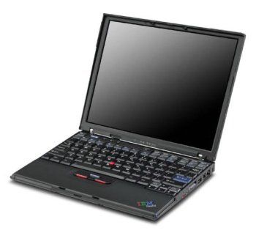
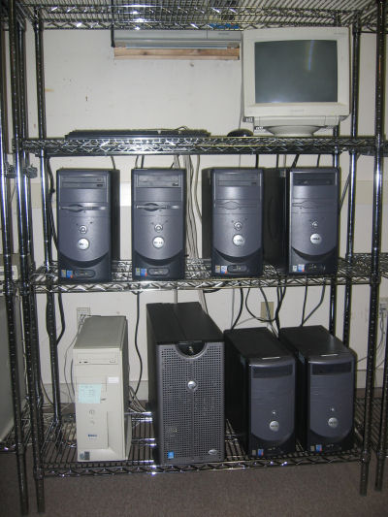
What they want.
What they get.

Slide 12
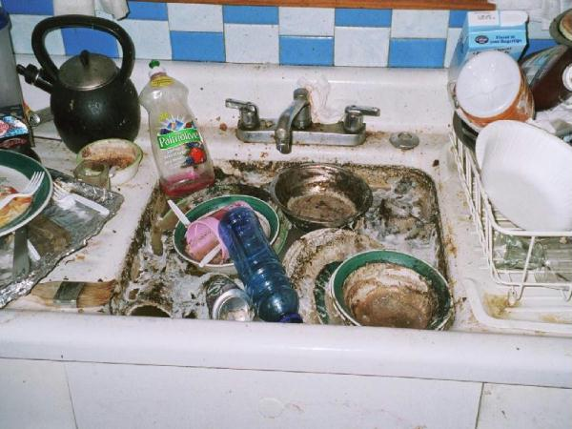
The Traditional
Application Model?
Every program attempts to grow until it can read mail. - Jamie Zawinski

Slide 13
An Old Idea: The Unix Model
input < grep | sort | uniq > output

Slide 14
Advantages of Little Processes
Easy to distribute across machines.
Easy to develop and test independently.
Easy to checkpoint halfway.
Easy to troubleshoot and continue.
Easy to observe the dependencies between components.
Easy to control resource assignments from an outside process.

Slide 15
Our approach:
Encourage users to decompose their applications into simple programs.
Give them frameworks that can assemble them into programs of massive scale with high reliability.

Slide 16


Working with Abstractions
A1
A1
A2
A2
F
An
Bn
AllPairs( A, B, F )
Custom
Workflow
Engine
Cloud or Grid
Compact Data Structure

Slide 17
What’s Beyond Map-Reduce?

Slide 18
Examples of Abstractions
AllPairs( A, B, F ) -> M
Wavefront( X, Y, F ) -> M
A1
A2
A3
R[0,4]
F
R[2,4]
R[3,4]
R[4,4]
x
B1
F
F
F
R[0,3]
d
y
R[3,2]
R[4,3]
x
F
x
F
R[0,2]
d
y
d
y
R[4,2]
x
F
x
F
x
F
B2
F
F
F
d
y
d
y
d
y
R[0,1]
F
F
F
F
x
x
x
x
R[0,0]
d
y
d
y
d
y
d
y
B3
F
F
F
R[1,0]
R[2,0]
R[3,0]
R[4,0]
Classify( T, P, F, R ) -> V
T1
F
V1
T
P
T2
F
V2
C
V
T3
F
V3
R

Slide 19
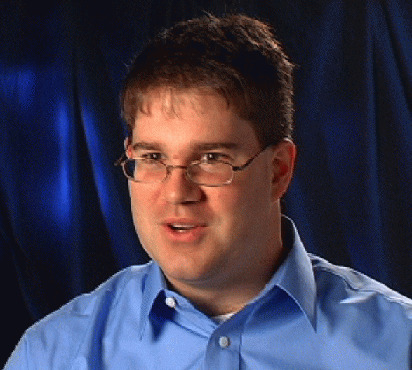


Example: Biometrics Research
Goal: Design robust face comparison function.
F
F
0.97
0.05

Slide 20






Similarity Matrix Construction
 | 1.0 | 0.8 | 0.1 | 0.0 | 0.0 | 0.1
 |  | 1.0 | 0.0 | 0.1 | 0.1 | 0.0
 |  |  | 1.0 | 0.0 | 0.1 | 0.3
 |  |  |  | 1.0 | 0.0 | 0.0
 |  |  |  |  | 1.0 | 0.1
 |  |  |  |  |  | 1.0
Challenge Workload:
60,000 images
1MB each
.02s per F
833 CPU-days
600 TB of I/O

Slide 21
All-Pairs Abstraction
AllPairs( set A, set B, function F )
returns matrix M where
M[i][j] = F( A[i], B[j] ) for all i,j
A1
A1
A2
A3
A1
allpairs A B F.exe
An
AllPairs(A,B,F)
B1
F
F
F
B1
B1
Bn
B2
F
F
F
F
B3
F
F
F
Moretti et al, All-Pairs: An Abstraction for Data Intensive Cloud Computing, IPDPS 2008.

Slide 22
User Interface
% allpairs compare.exe set1.data set2.data
Output:
img1.jpg img1.jpg 1.0
img1.jpg img2.jpg 0.35
img1.jpg img3.jpg 0.46
…

Slide 23
How Does the Abstraction Help?
The custom workflow engine:
  Chooses right data transfer strategy.
  Chooses blocking of functions into jobs.
  Recovers from a larger number of failures.
  Predicts overall runtime accurately.
  Chooses the right number of resources.
All of these tasks are nearly impossible for arbitrary workloads, but are tractable (not trivial) to solve for a specific abstraction.

Slide 24
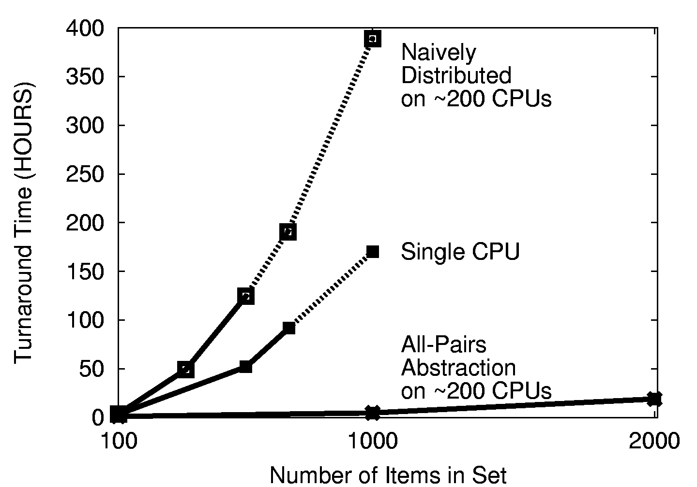

Slide 25
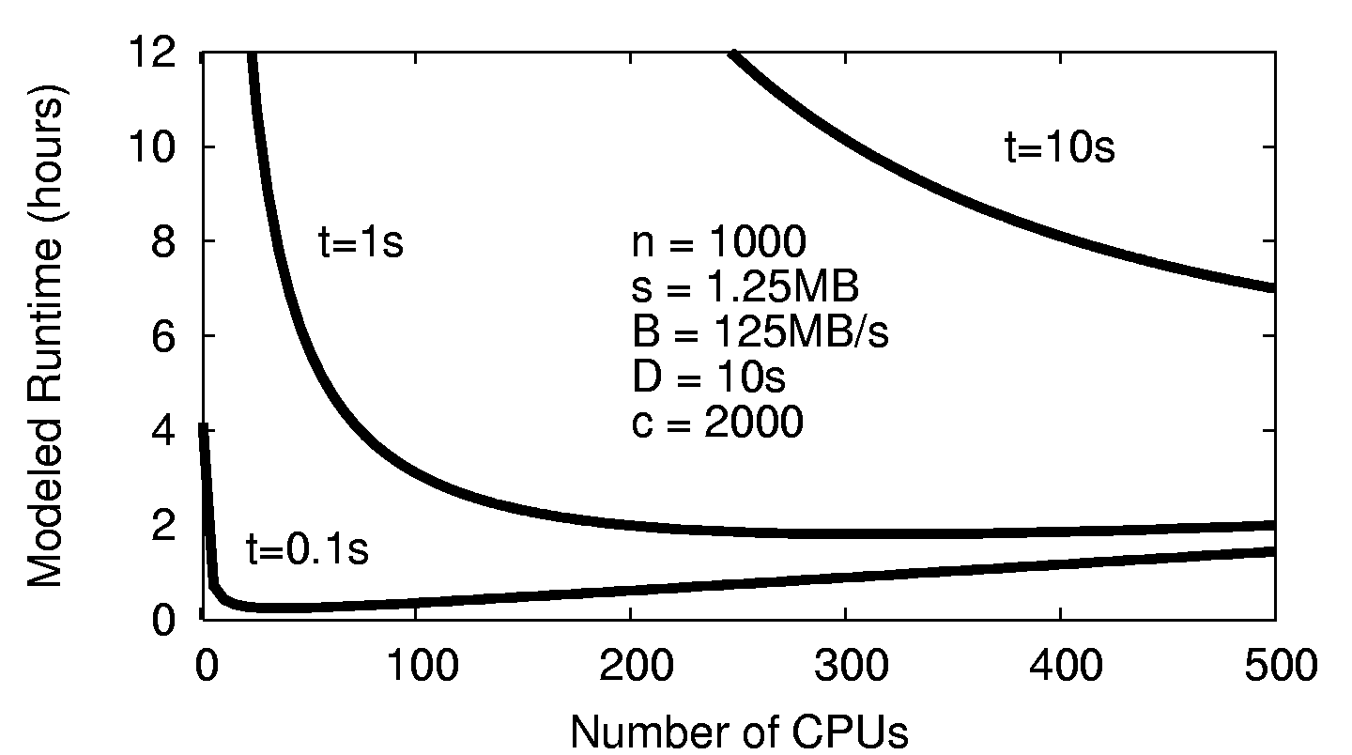
Choose the Right # of CPUs

Slide 26
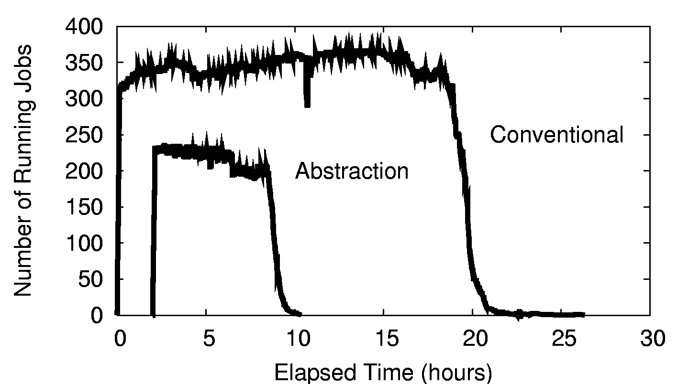
Resources Consumed

Slide 27
All-Pairs in Production
Our All-Pairs implementation has provided over 57 CPU-years of computation to the ND biometrics research group in the first year.
Largest run so far: 58,396 irises from the Face Recognition Grand Challenge. The largest experiment ever run on publically available data.
Competing biometric research relies on samples of 100-1000 images, which can miss important population effects.
Reduced computation time from 833 days to 10 days, making it feasible to repeat multiple times for a graduate thesis. (We can go faster yet.)

Slide 28
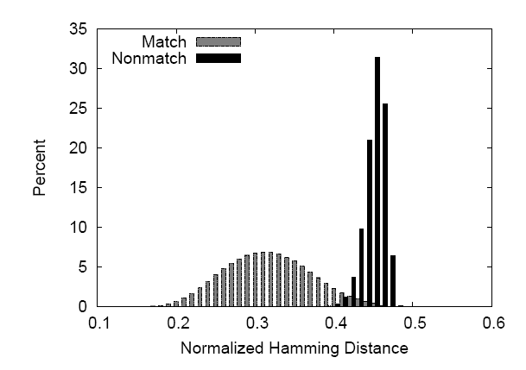

Slide 29
All-Pairs Abstraction
AllPairs( set A, set B, function F )
returns matrix M where
M[i][j] = F( A[i], B[j] ) for all i,j
A1
A1
A2
A3
A1
allpairs A B F.exe
An
AllPairs(A,B,F)
B1
F
F
F
B1
B1
Bn
B2
F
F
F
F
B3
F
F
F
Moretti et al, All-Pairs: An Abstraction for Data Intensive Cloud Computing, IPDPS 2008.

Slide 30
Are there other abstractions?

Slide 31
Classify Abstraction
Classify( T, R, N, P, F )
T = testing set R = training set
N = # of partitions F = classifier
T1
F
V1
T
P
T2
F
V2
C
V
T3
F
V3
R
Chris Moretti et al, Scaling up Classifiers to Cloud Computers, ICDM 2008.

Slide 32
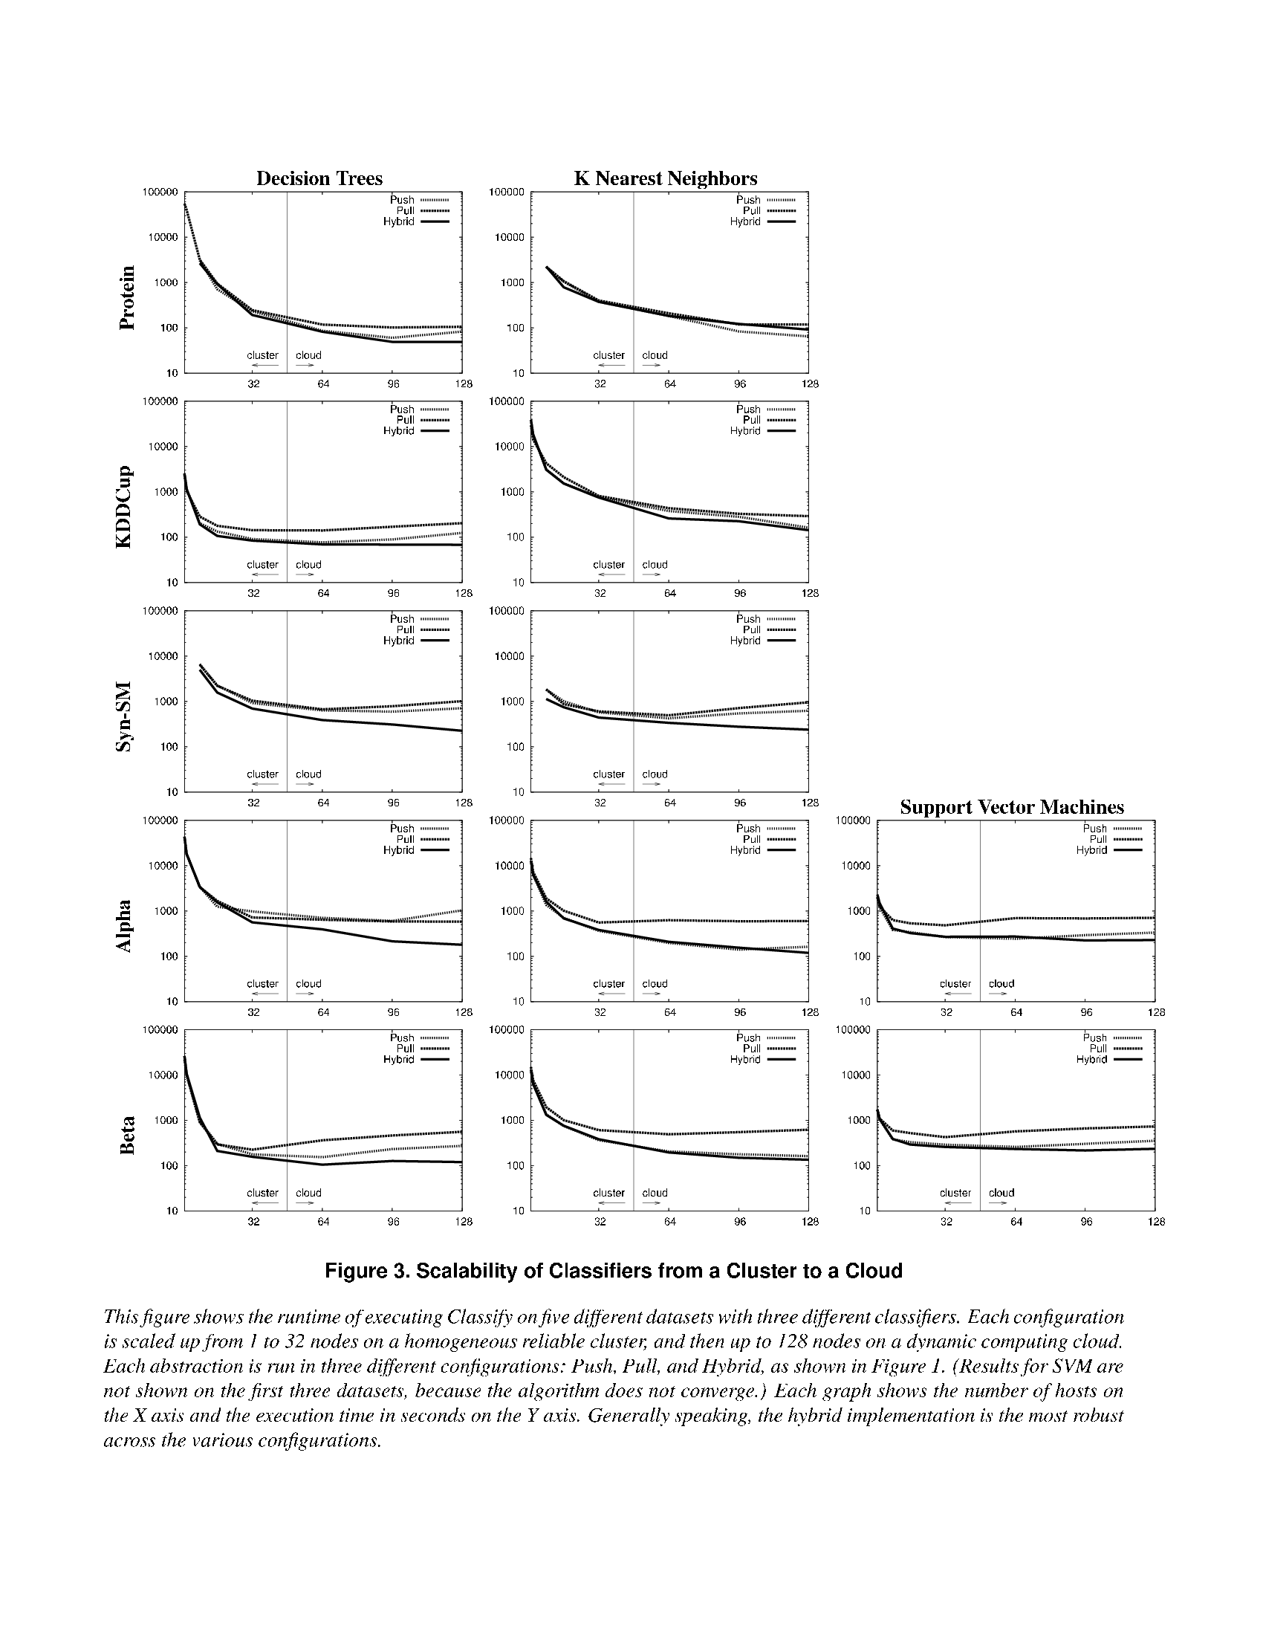
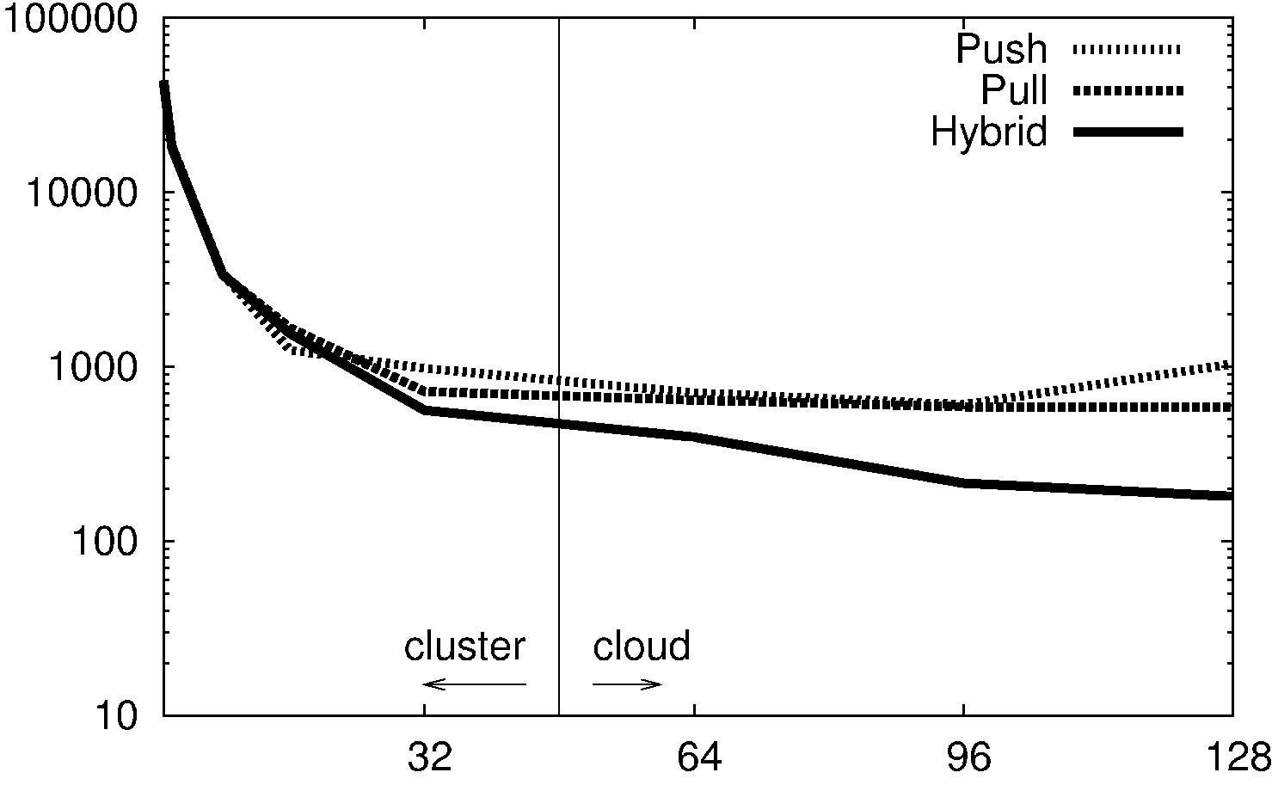

Slide 33
Wavefront( matrix M, function F(x,y,d) )
returns matrix M such that
M[i,j] = F( M[i-1,j], M[I,j-1], M[i-1,j-1] )
M[0,4]
M[2,4]
M[3,4]
M[4,4]
x
F
d
y
M[0,3]
M[3,2]
M[4,3]
Wavefront(M,F)
x
F
x
F
M
d
y
d
y
M[0,2]
x
M[4,2]
x
F
x
F
F
d
y
d
y
d
y
F
M[0,1]
x
F
x
F
x
F
x
F
d
y
d
y
d
y
d
y
M[0,0]
M[1,0]
M[2,0]
M[3,0]
M[4,0]
Li Yu et al, Harnessing Parallelism in Multicore Clusters with the
All-Pairs, Wavefront, and Makeflow Abstractions, Journal of Cluster Computing, 2010.

Slide 34
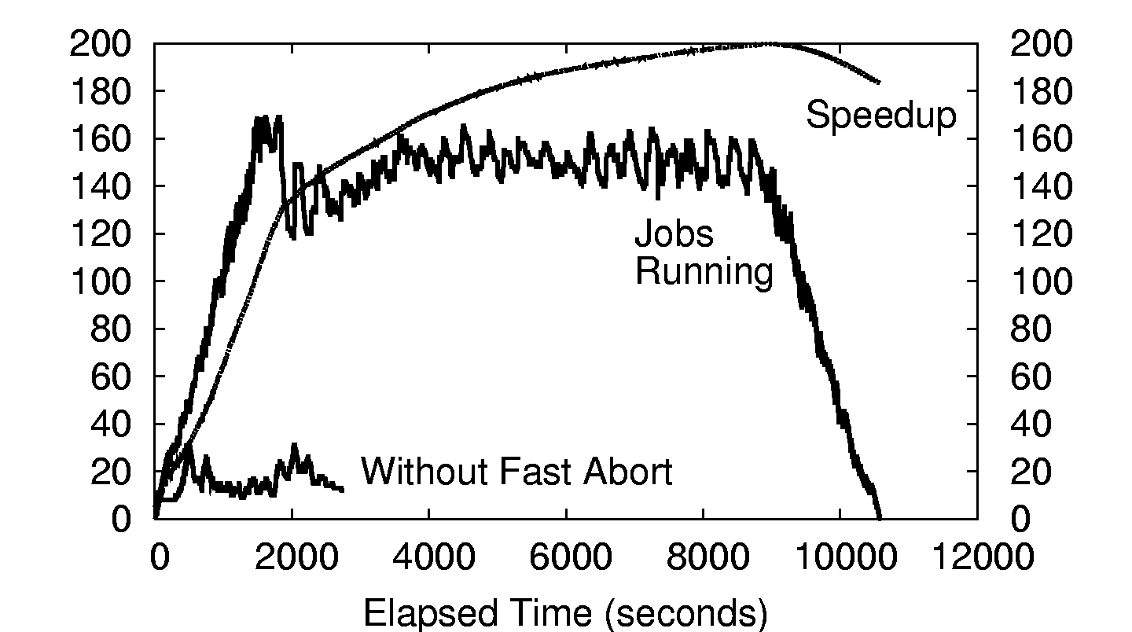
500x500 Wavefront on ~200 CPUs

Slide 35
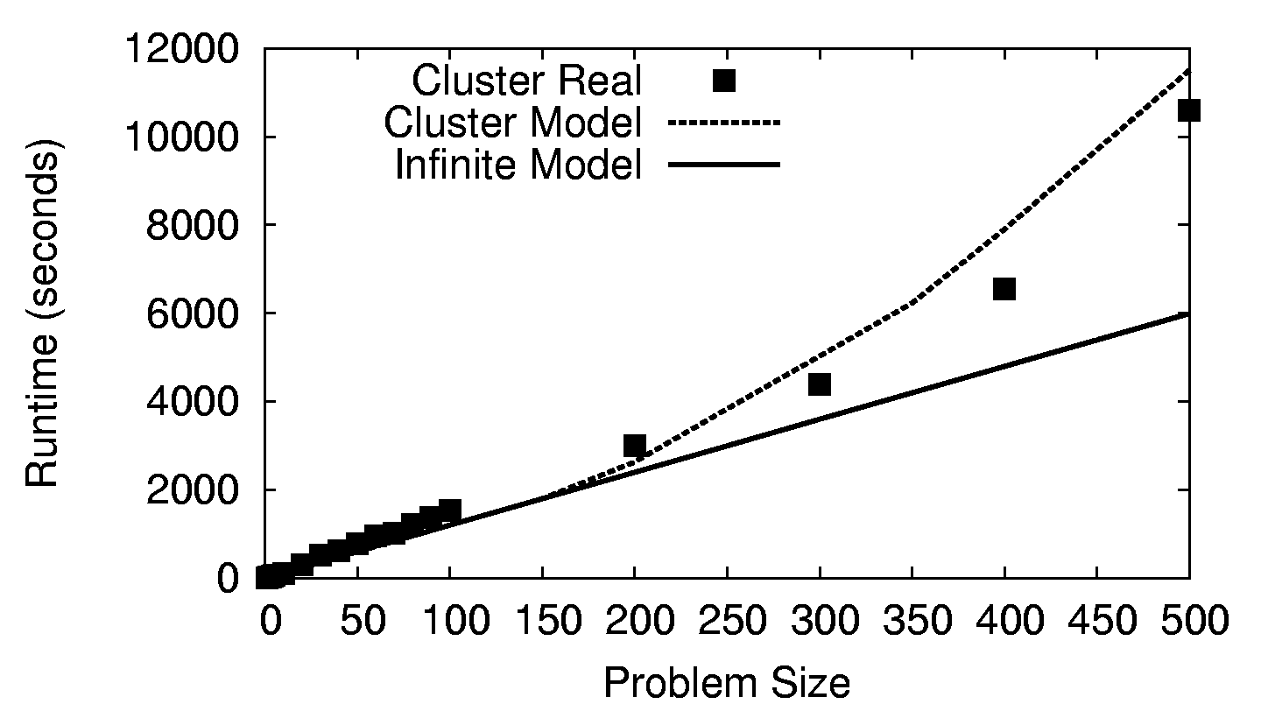
Wavefront on a 200-CPU Cluster

Slide 36
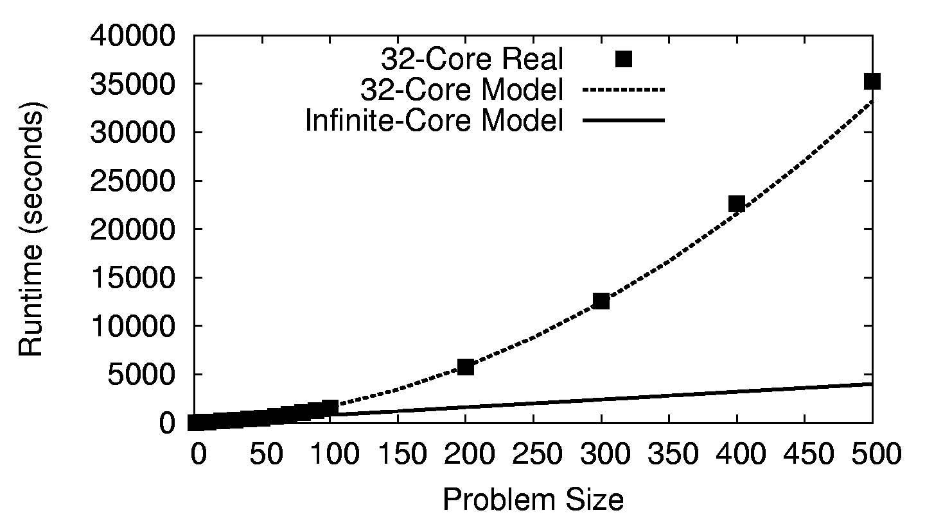
Wavefront on a 32-Core CPU

Slide 37
What if your application doesn’t fit a regular pattern?

Slide 38
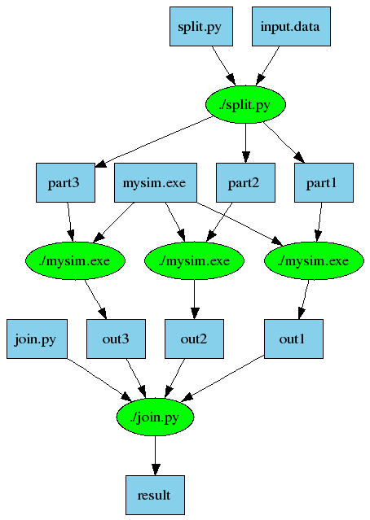
Another Old Idea: Make
part1 part2 part3: input.data split.py
./split.py input.data
out1: part1 mysim.exe
./mysim.exe part1 >out1
out2: part2 mysim.exe
./mysim.exe part2 >out2
out3: part3 mysim.exe
./mysim.exe part3 >out3
result: out1 out2 out3 join.py
./join.py out1 out2 out3 > result

Slide 39
Makeflow: Direct Submission
Private
Cluster
Shared
SGE
Cluster
Makefile
Makeflow
submit
jobs
Campus
Condor
Pool
Public
Cloud
Provider
Local Files and Programs

Slide 40
Problems with Direct Submission
Software Engineering: too many batch systems with too many slight differences.
Performance: Starting a new job or a VM takes 30-60 seconds. (Universal?)
Stability: An accident could result in you purchasing thousands of cores!
Solution: Overlay our own work management system into multiple clouds.
  Technique used widely in the grid world.

Slide 41
Makeflow: Overlay Workerrs
sge_submit_workers
Private
Cluster
Shared
SGE
Cluster
Makefile
Wv
W
Hundreds of Workers in a
Personal Cloud
W
submit
tasks
W
W
W
Makeflow
Campus
Condor
Pool
Public
Cloud
Provider
W
W
W
W
W
W
W
Local Files and Programs
condor_submit_workers
ssh

Slide 42
Makeflow: Overlay Workers
worker
100s of workers
dispatched to
the cloud
worker
bfile: afile prog
prog afile >bfile
worker
worker
worker
worker
queue
tasks
detail of a single worker:
makeflow
master
work
queue
put prog
put afile
exec prog afile > bfile
get bfile
worker
tasks
done
Two optimizations:
Cache inputs and output.
Dispatch tasks to nodes with data.
afile
prog
bfile

Slide 43
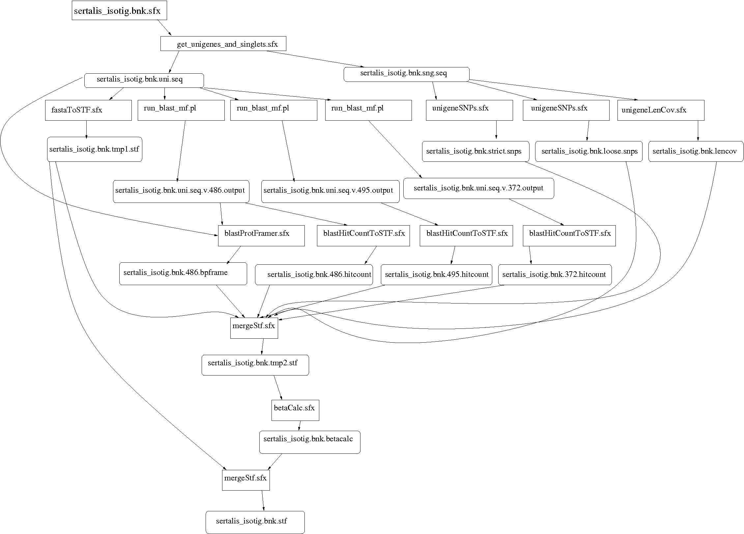
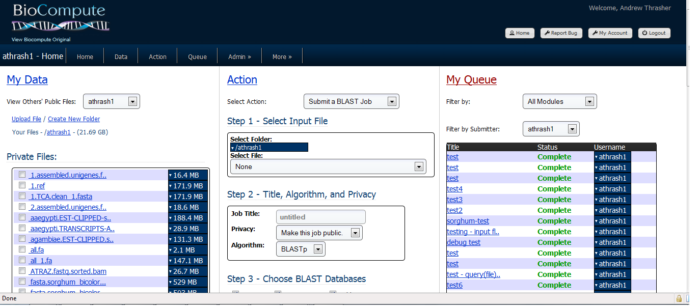
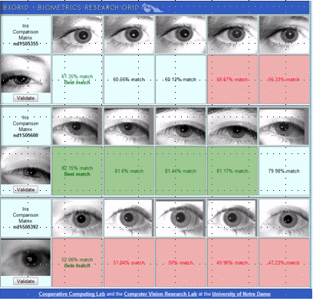
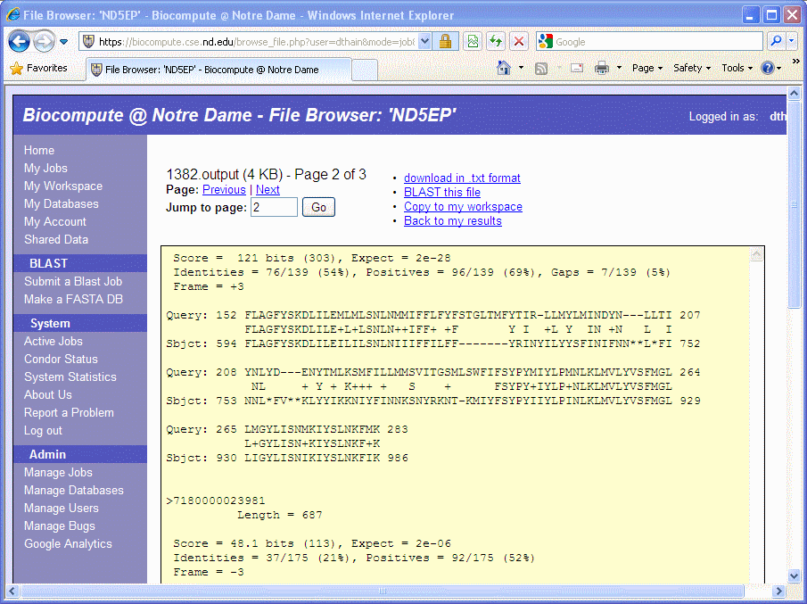
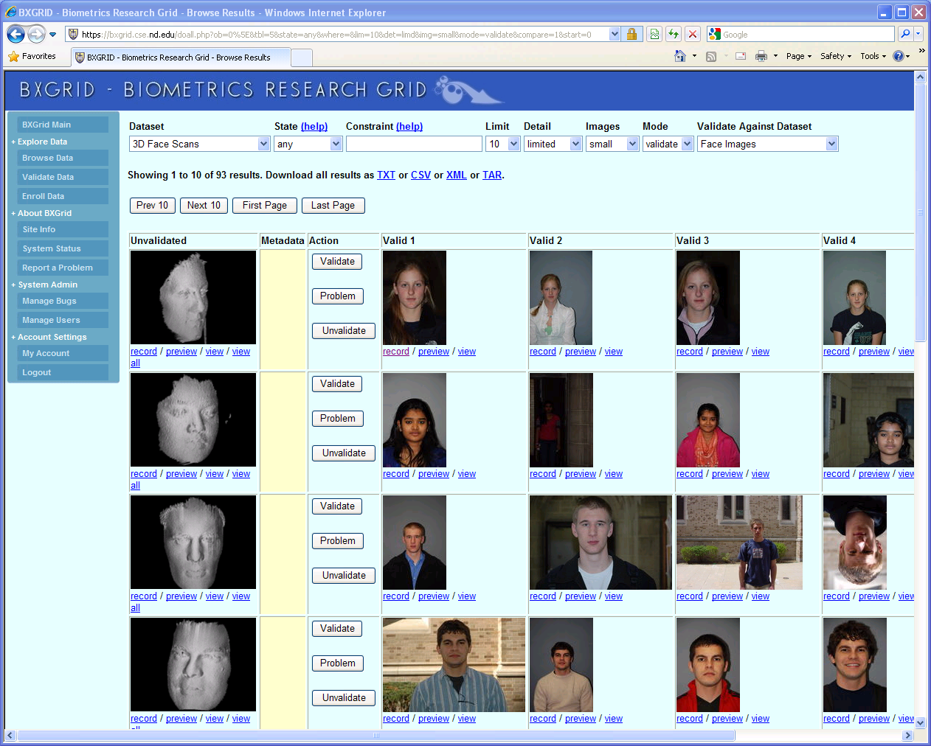
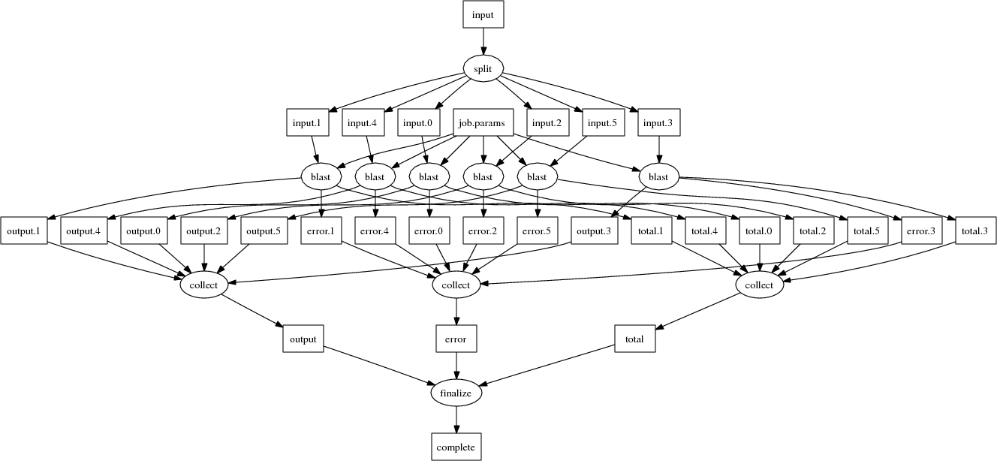
Makeflow Applications

Slide 44
Why Users Like Makeflow
Use existing applications without change.
Use an existing language everyone knows. (Some apps are already in Make.)
Via Workers, harness all available resources: desktop to cluster to cloud.
Transparent fault tolerance means you can harness unreliable resources.
Transparent data movement means no shared filesystem is required.

Slide 45
Examples of Abstractions
AllPairs( A, B, F ) -> M
Wavefront( X, Y, F ) -> M
A1
A2
A3
R[0,4]
F
R[2,4]
R[3,4]
R[4,4]
x
B1
F
F
F
R[0,3]
d
y
R[3,2]
R[4,3]
x
F
x
F
R[0,2]
d
y
d
y
R[4,2]
x
F
x
F
x
F
B2
F
F
F
d
y
d
y
d
y
R[0,1]
F
F
F
F
x
x
x
x
R[0,0]
d
y
d
y
d
y
d
y
B3
F
F
F
R[1,0]
R[2,0]
R[3,0]
R[4,0]
Classify( T, P, F, R ) -> V
T1
F
V1
T
P
T2
F
V2
C
V
T3
F
V3
R

Slide 46
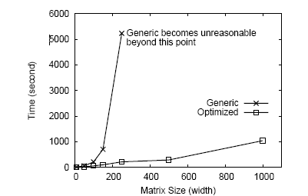
What is the Cost of Using the Wrong Tool?
Express All-Pairs
by using Makeflow
Use the All-Pairs
tool directly.

Slide 47
A question to consider over coffee:
Can you implement
{ All-Pairs / Classify / Wavefront }
(efficiently) using Map-Reduce?

Slide 48
Partial Lattice of Abstractions
Robust
Performance
Expressive
Power
All-Pairs
Some Pairs
Bag of Tasks
Wavefront
Map Reduce
Directed Graph
Functional Program

Slide 49
I would like to posit that computing’s central challenge how not to make a mess of it has not yet been met.
- Edsger Djikstra

Slide 50
The 0, 1 … N attitude.
Code designed for a single machine doesn’t worry about resources, because there isn’t any alternative. (Virtual Memory)
But in a distributed system, you usually scale until some resource is exhausted!
App devels are rarely trained to deal with this problem. (Can malloc or close fail?)
Opinion: All software needs to do a better job of advertising and limiting resources. (Frameworks could exploit this.)

Slide 51
Too much concurrency!
Vendors of multi-core projects are pushing everyone to make everything concurrent.
Hence, many applications now attempt to use all available cores at their disposal, without regards to RAM, I/O, disk…
Two apps running on the same machine almost always conflict in bad ways.
Opinion: Keep the apps simple and sequential, and let the framework handle concurrency.

Slide 52
To succeed, get used to failure.
Any system of 1000s of parts has failures, and many of them are pernicious:
  Black holes, white holes, deadlock…
To discover failures, you need to have a reasonably detailed model of success:
  Output format, run time, resources consumed.
Need to train coders in classic engineering:
  Damping, hysteresis, control systems.
Keep failures at a sufficient trickle, so that everyone must confront them.

Slide 53
Federating resources.
10 years ago, we had (still have) multiple independent computing grids, each centered on a particular institution.
Grid federation was widely desired, but never widely achieved, for many technical and social reasons.
But, users ended up developing frameworks to harness multiple grids simultaneously, which was nearly as good.
Let users make overlays across systems.

Slide 54
Examples of Abstractions
AllPairs( A, B, F ) -> M
Wavefront( X, Y, F ) -> M
A1
A2
A3
R[0,4]
F
R[2,4]
R[3,4]
R[4,4]
x
B1
F
F
F
R[0,3]
d
y
R[3,2]
R[4,3]
x
F
x
F
R[0,2]
d
y
d
y
R[4,2]
x
F
x
F
x
F
B2
F
F
F
d
y
d
y
d
y
R[0,1]
F
F
F
F
x
x
x
x
R[0,0]
d
y
d
y
d
y
d
y
B3
F
F
F
R[1,0]
R[2,0]
R[3,0]
R[4,0]
Classify( T, P, F, R ) -> V
T1
F
V1
T
P
T2
F
V2
C
V
T3
F
V3
R

Slide 55
A Team Effort
Faculty:
  Patrick Flynn
  Scott Emrich
  Jesus Izaguirre
  Nitesh Chawla
  Kenneth Judd
Grad Students
  Hoang Bui
  Li Yu
  Peter Bui
  Michael Albrecht
  Peter Sempolinski
  Dinesh Rajan
Undergrads
  Rachel Witty
  Thomas Potthast
  Brenden Kokosza
  Zach Musgrave
  Anthony Canino
NSF Grants CCF-0621434, CNS-0643229, and CNS 08-554087.

Slide 56
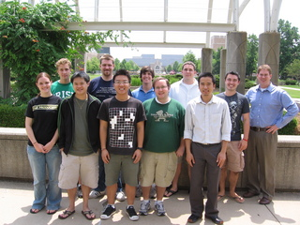
The Cooperative Computing Lab
http://www.nd.edu/~ccl

